Slide 1
Professional Development
through
Virtual Creativity
March 25, 2020
Robert Seth Price, Senior Scholar
National Urban Alliance

Slide 2
Virtual PD
Watching
& Doing
Overview
Creating Our
Virtual PD
Blog and
Reflection

Slide 3
Keep the Pedagogical Flow Map in Mind:
—watching today
—creating for students
—modeling for teachers
—creating examples

Slide 4
Key Word Prediction
coronavirus
COVID 19
global
flu
pathogens
impose
social distancing
vaccine
isolation
quarantine

Slide 5
Coronavirus is any group of RNA viruses that cause a variety of diseases in humans and other animals.
To avoid the Coronavirus, remember to
wash your hands regularly and avoid
touching your face.

Slide 6
Priming
To develop mini PD lessons using NUA HOPs for teachers that can also be used for students.
We will watch a short PD video screencast style that you will observe and process from doing.
Processing
In pairs will create a flow map of doing a short virtual PD on
a provided topic that you will create using HOPs as part
of the process.
Retaining for Understanding
We will share our developed flow maps on the topic including
how each pair will create their virtual PD.

Slide 7
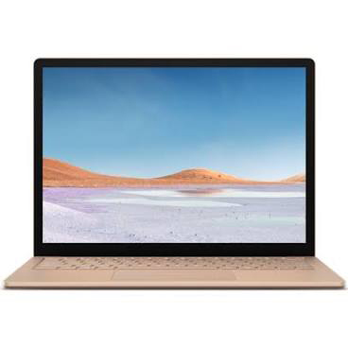
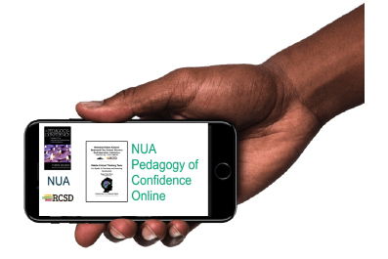
We will watch a PD video with the goals of:
Experiencing the process,
Reflecting on purpose for teachers and students,
Developing our own PD videos in pairs.

Slide 8
You will be asked to find a person to collaborate with:
At your location,
At another location with a phone or Google Hangout.

Slide 9
https://vimeo.com/399740808

Slide 10
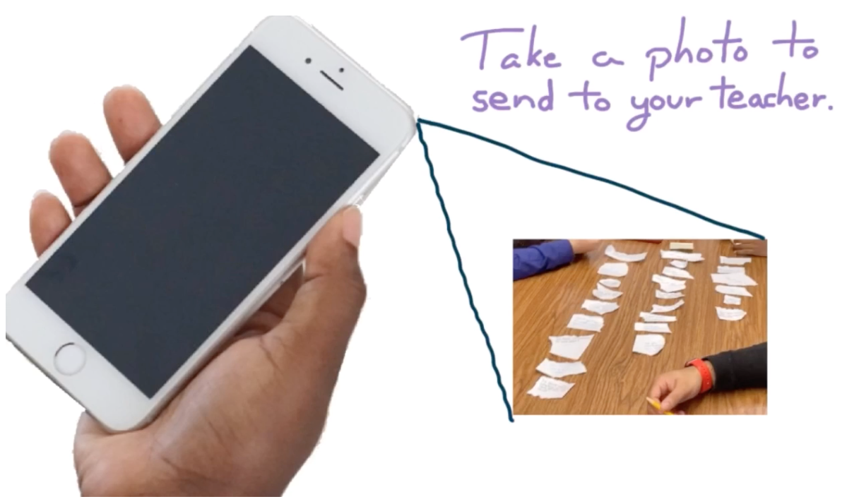
How can we share virtually?

Slide 11
It is your turn in pairs to create a storyboard with a flow map for a
PD lesson. Key ideas are:
be approximately 5 minutes
using NUA HOPs strategies
practical for students
a PD for teachers
The Topic: Self Care During Coronavirus

Slide 12
The Topic: Self Care During Coronavirus
Keep in mind the PFM and HOPS

Slide 13
The Topic: Self Care During Coronavirus
Be Creative:
with your content
how you will present
how you will create
presenting to the group

Slide 14
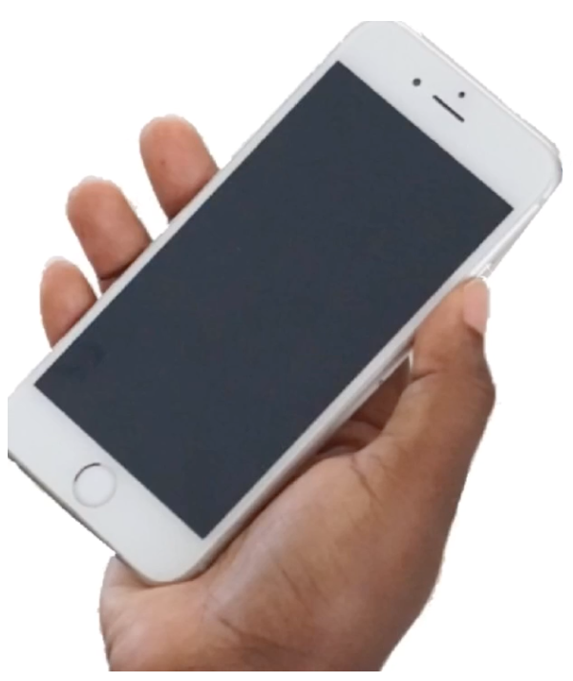
Share to the Whole Group

Slide 15
Reflections
and
Questions

Slide 16
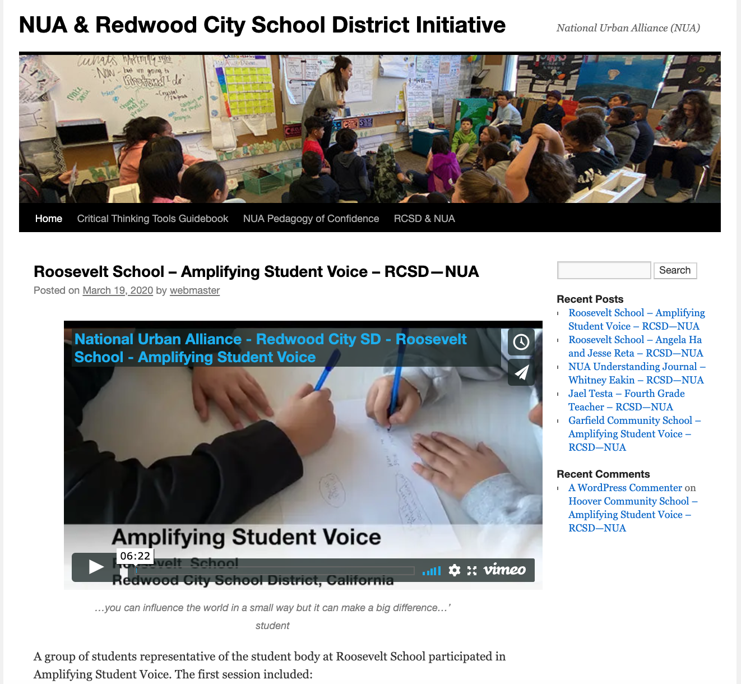
NUA — RCSD Blog
http://redwoodcity.nuatc.org/

Slide 17
NUA — RCSD Blog
Why?
Purpose?
For Whom?
Content?
http://redwoodcity.nuatc.org/

Slide 18
Reflections
Questions

Slide 19
Thank You
robert@eggplant.org
www.eggplant.org
www.nuatc.org

