Slide 1
Flow of the Session
8:00 - 12:00
Introduction to the
Pedagogical Flow Map
Stefanie
12:00 - 12:30
LUNCH
12:30 - 2:30
NUA Pedagogy of Confidence Online
Robert
2:30 - 4:00
Debriefing, Planning & Next Steps
Linda, Maria, Robert, Stefanie

Slide 2
The Pedagogical Flow Map
A Journey in Instructional Design
™National Urban Alliance for Effective Education
Stefanie B. Rome
‹#›
Notes:
‹#›

Slide 3
On Scaffolding…
At the beginning of learning, students need a great deal of support;
Gradually, this support is taken away to allow students to try their independence. This is what Pearson (1985) called the gradual release of responsibility.
If students are unable to achieve independence, the teacher brings back the support system to help students experience success until they are able to achieve independence (J.D. Cooper, 1993).
‹#›
Notes:
‹#›

Slide 4
3 Critical Systems
Teacher to Student-Student to Teacher
Teacher to Content (Standards)
Teacher to Delivery System
‹#›

Slide 5
Introduction
Standards: Students will be able to describe a character using adjectives by identifying traits and qualities of the character.
Assessment: After experiencing a text, students will describe a person using adjectives,
providing evidence from text to support their descriptors, synthesize information in written form, and transfer learning to a new genre.
‹#›
Notes:
‹#›

Slide 6
On Concepts…
“Concepts are deep and essential understandings those understandings that drive us and govern our sense of purpose.” - Caine and Caine
“Deep knowledge transfers across time and cultures and provides a conceptual structure for thinking about related and new ideas.” - H. Lynn Erikson
‹#›

Slide 7
On Teaching Conceptually…
Higher complexity moves from facts to concepts for enduring understanding
Higher complexity requires critical, conceptual, and creative thinking
Topic-based/Fact-based curriculum is boring
In a thinking classroom, facts become tools to develop concepts and generalizations and become building blocks to support conceptual learning.
As factual coverage increases, conceptual engagement decreases…along with motivation for learning.”
Motivation is intrinsically generated by the conceptual mind.
‹#›
Notes:
‹#›

Slide 8
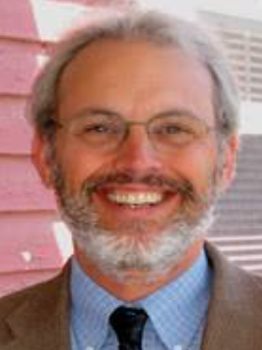
Concept Development
Concept: Resilience
Strategy: Circle Map & Frame
www.thinkingfoundation.org
www.designsforthinking
www.thinkingschoolsinternational.com
‹#›
Notes:
‹#›

Slide 9
Resilience
Behaviors
Characteristics

Slide 10
The Power of Vocabulary
Researchers estimate a difference of from 4,500 to 5,400 words for underachievers in school versus high achievers. -Hart and Risley
Adequate reading comprehension depends on a person knowing the meaning of between 90 and 95 percent of the words in a text.
Those who know 90 percent of the words in a text will understand its meaning and, because they understand, they will also begin to learn the other 10 percent. -Hirsh
‹#›
Notes:
‹#›

Slide 11
On Vocabulary Development
Nagy summarizes the research on effective vocabulary teaching as coming down to three critical notions: Integration, Repetition, and Meaningful Use.
Integration: connecting new vocabulary to prior knowledge
Repetition: encountering/using the word/concept many times
Meaningful use: multiple opportunities to use new words in reading, writing and discussion.
‹#›
Notes:
‹#›

Slide 12
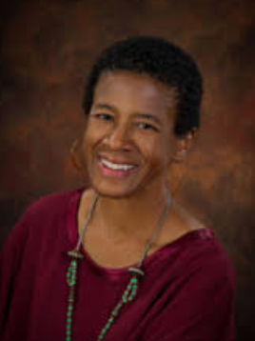
Vocabulary Development
Words: resilience, confidence, remarkable, conquer, deft, attitude, assault, limit
Strategy: Dancing Definitions
http://successfulteachers.com
‹#›
Notes:
‹#›

Slide 13
Dancing Definitions
The Teaching Part
Questioning
Scaffolding
It’s all about
INQUIRY
The Mastery Part
Recitation
Repetition
It’s all about
INTERNALIZATION
‹#›
Notes:
‹#›

Slide 14
Dancing Definitions
The Steps:
Teacher identifies 10 -15 words from the text that students may struggle with the meaning of.
Teacher looks up the words in the dictionary
Teacher “reworks” the definitions so that they have some rhythm and flow
Teacher creates Dancing Definitions charts
‹#›
Notes:
‹#›

Slide 15
On Skill Development…
“Once cognitive skills are taught and cultural experiences are enriched, even the most underperforming individuals can extend their intellectual powers dramatically.”
-Dr. Reuven Feuerstein
‹#›
Notes:
‹#›

Slide 16
Skill Development
new strategies/familiar content
‹#›
Notes:
‹#›

Slide 17
Skill Development
EXPLICIT STRATEGY/SKILL INSTRUCTION
Skills: Describe, Provide Evidence, Synthesize, Transfer (Genre Switching)
Strategies: Bubble Map, Frame, Quick Write, WWWW&H
‹#›
Notes:
‹#›

Slide 18
Introduce The Text (Guided Practice)
Text: Amazing Story
Strategies:
Key Word Prediction
View & Capture
Bubble Map & Frame
Metacognition Frame
Genre Switching (WWWW&H)
‹#›
Notes:
‹#›

Slide 19
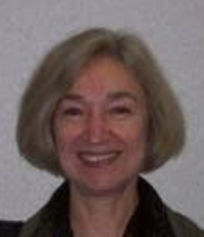
Amazing Story
Key Word Prediction
Denise Nessel https://www.nuatc.org/denise-nessel-ph-d/
confidence skates
assault 2 dolphins
14 Ben pride
confidence sound smell
trash can car touch
car fearless
5 echolocation
‹#›
Notes:
‹#›

Slide 20
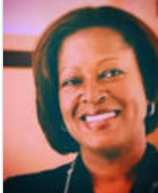
View & Capture
Stefanie Rome
scbrome320@gmail.com
nuatc.org
We will view the video text twice
Just take it in
View & Capture:
Write or draw examples from the text that demonstrate each of the ideas in your View & Capture frame.
Share what you captured with your partner.
Participate in the whole group discussion.
‹#›

Slide 21
Amazing Story Video
‹#›
Notes:
‹#›

Slide 22
View & Capture Frame Write or draw examples from the text that demonstrate evidence of the ideas in each box from main character’s life
Strengths | Challenges
Victories | Support
‹#›

Slide 23
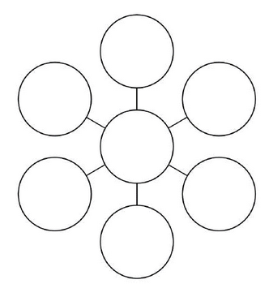
Bubble Map Describing Ben Underwood
Textual evidence
Textual evidence
adjective
Textual evidence
adjective
adjective
Ben
Underwood
adjective
adjective
adjective
Textual evidence
Textual evidence
Textual evidence

Slide 24
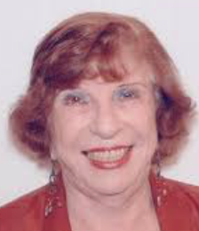
Metacognition Frame
Evelyn Rothstein
https://us.sagepub.com/en-us/nam/author/evelyn-b-rothstein
I know I know something about ____________________.
First, ________________________________________.
Second, _______________________________________.
In addition, ____________________________________.
Finally, _______________________________________.
Now you know something that I know about __________.
‹#›
Notes:
‹#›

Slide 25
Genre Switching WWWW&H
1. “Who, What, When, Where and How”
2. “Who, What, When, Where and How”
3. “Who?” ______________ (4 counts)
4. “What?” ______________ (4 counts)
5. “When” ______________ (4 counts)
6. “Where” ______________ (4 counts)
7. “How” ______________ (4 counts)
8. “Who, What, When, Where and How”
‹#›
Notes:
‹#›

Slide 26
On Mediation
If students are unable to achieve independence, the teacher brings back the support system to help students experience success until they are able to achieve independence (J.D. Cooper, 1993).
‹#›

Slide 27
On Mediation (Feuerstein, 1982)
The first role that a classroom teacher can play for students is that of a mediator and facilitator of learning
The teacher is seen as a mediating agent who interposes him or herself between the child and external sources of stimulation
The teacher mediates the world to the child by framing, selecting, focusing, and feeding back environmental experiences in such a way as to produce in him or her appropriate learning sets and habits
The "mediators" of our early learning interpose themselves between us and the world to help make our experiences meaningful.
‹#›

Slide 28
Resilience Research Center (Independent Learning)
Identify a notable person that you believe is resilient.
Research that person to find information that supports your belief.
Create a Bubble Map that describes the person.
Frame your Bubble Map and provide evidence from your research that supports your descriptors.
Imagine that the person was nominated for “The Room 9 Resilience Award”.
Use the information from your Bubble Map and Frame to write a letter of recommendation for her or him explaining why they should win the award.
Create a WWWW&H rap about the person.
‹#›
Notes:
‹#›

Slide 29
Teacher (Self) Reflection
The research is clear that organizational change is the result of individuals changing themselves and their personal practices, not of "top-down" mandates (Airasian & Gullickson, 1997).
Self-reflection gives teachers a voice and control over their own practice.
‹#›
Notes:
‹#›

Slide 30
Teacher (Self) Reflection
Reflective Question (example):
“What practices have I included to ensure that my students will be successful?”
‹#›
Notes:
‹#›

Slide 31
Release the Lesson Independent Practice
New Text: Inspirational Story
Same Strategies:
Key Word Prediction
View & Capture
Bubble Map & Frame
Writing (Quick Write)
Genre Switching (WWWW&H)
‹#›
Notes:
‹#›

Slide 32
Inspirational Story
2 1/2 special surgery challenges
speaker sports missing games
1 kid thumb
leg disability 24 helper
track motivational microscope
2 understand nerves
‹#›
Notes:
‹#›

Slide 33
View & Capture
We will view the video text twice
Just take it in
View & Capture:
Write or draw examples from the text that demonstrate each of the ideas in your View & Capture frame.
Share what you captured with your partner.
Participate in the whole group discussion.
‹#›

Slide 34
Inspirational Story
‹#›
Notes:
‹#›

Slide 35
View & Capture Frame Write or draw examples from the text that demonstrate evidence of the ideas in each box from main character’s life
Strengths | Challenges
Victories | Support
‹#›

Slide 36
Bubble Map Describing Ben Underwood
Textual evidence
Textual evidence
adjective
Textual evidence
adjective
adjective
Ezra
Frech
adjective
adjective
adjective
Textual evidence
Textual evidence
Textual evidence

Slide 37
Metacognition Frame
I know I know something about ____________________.
First, ________________________________________.
Second, _______________________________________.
In addition, ____________________________________.
Finally, _______________________________________.
Now you know something that I know about __________.
‹#›
Notes:
‹#›

Slide 38
Genre Switching WWWW&H
1. “Who, What, When, Where and How”
2. “Who, What, When, Where and How”
3. “Who?” ______________ (4 counts)
4. “What?” ______________ (4 counts)
5. “When” ______________ (4 counts)
6. “Where” ______________ (4 counts)
7. “How” ______________ (4 counts)
8. “Who, What, When, Where and How”
‹#›
Notes:
‹#›

Slide 39
Self Assessment…
promotes learning
gives learners training in evaluation
gives both students and teachers a raised level of awareness of perceived levels of abilities
encourages learners to look at course content in a more discerning way
is highly motivating in terms of goal-orientation
expands the range of assessment techniques in the classroom
allows students to participate in their own evaluation
‹#›
Notes:
‹#›

Slide 40
How did we get here?
Relating Factor: helped us to
Circle Map
as
as
Define Resilience
‹#›
Notes:
‹#›

Slide 41
Student Reflection
Ask: If I gave you the test today, could you achieve an 80% or better on:
Describing a person using adjectives
Providing evidence from text to support your thoughts descriptors.
Synthesizing information into written form
Transferring learning to a new genre
Red = I am not ready.
Yellow = I have some reservations.
Green = I am ready!
‹#›
Notes:
‹#›

Slide 42
Concept Confirmation
Deep knowledge transfers across time and cultures and provides a conceptual structure for thinking about related and new ideas. - H. Lynn Erikson
Revisit Circle Map
Metacognition Frame
‹#›

Slide 43
Concept Confirmation
Strategies:
Circle Map (revisited)
‹#›
Notes:
‹#›

Slide 44
Resilience
Behaviors
Characteristics

Slide 45
On Teaching Toward Mastery/Understanding…
A teacher who expects and insists on excellence brings on mastery.
Mastery is related to transformation and the expectations of achieving ever higher levels of excellence; reaching for that ultimate goal of being in sync with the natural world. -Augusta Mann
‹#›
Notes:
‹#›

Slide 46
Assessment
New Text: Cesar Chavez: Fasts
Same Concept and Strategies:
Revisit Circle Map
Bubble Map/Frame
Writing/Genre Switching
‹#›
Notes:
‹#›

Slide 47
Assessment
Assessment: After experiencing the text, create a Bubble Map using adjectives that describe Cesar Chavez, add a frame to your Bubble Map and provide evidence from text to supports each descriptor, synthesize the information from your Bubble Map and Frame in written form, transfer what you’ve learned into the WWWW&H genre.
‹#›
Notes:
‹#›

Slide 48
Cesar Chavez Fasts
overcome 8 symbol
movement achieve give
violence sacrifice commitment
pesticide values leaflet
farmers organize 1968
eagle 1988 dying
hero life courage
justice suffer
‹#›
Notes:
‹#›

Slide 49
View & Capture
We will view the video text twice
Just take it in
View & Capture:
Write or draw examples from the text that demonstrate each of the ideas in your View & Capture frame.
Share what you captured with your partner.
Participate in the whole group discussion.
‹#›

Slide 50
View & Capture Frame Write or draw examples from the text that demonstrate evidence of the ideas in each box from main character’s life
Strengths | Challenges
Victories | Support
‹#›

Slide 51
Bubble Map Describing Ben Underwood
Textual evidence
Textual evidence
adjective
Textual evidence
adjective
adjective
Cesar
Chavez
adjective
adjective
adjective
Textual evidence
Textual evidence
Textual evidence

Slide 52
Cesar Chavez Fasts Video
‹#›
Notes:
‹#›

Slide 53
Metacognition Frame
I know I know something about ____________________.
First, ________________________________________.
Second, _______________________________________.
In addition, ____________________________________.
Finally, _______________________________________.
Now you know something that I know about __________.
‹#›

Slide 54
Genre Switching WWWW&H
1. “Who, What, When, Where and How”
2. “Who, What, When, Where and How”
3. “Who?” ______________ (4 counts)
4. “What?” ______________ (4 counts)
5. “When” ______________ (4 counts)
6. “Where” ______________ (4 counts)
7. “How” ______________ (4 counts)
8. “Who, What, When, Where and How”
‹#›

Slide 55
Assessment
Assessment: After experiencing the text, create a Bubble Map using adjectives that describe Cesar Chavez, add a frame to your Bubble Map and provide evidence from text to supports each descriptor, synthesize the information from your Bubble Map and Frame in written form, transfer what you’ve learned into the WWWW&H genre.
‹#›

Slide 56
Home Again… Student Success
Demonstration of Mastery/Understanding
‹#›

